Slide 1

DEPARTMENT OF INFORMATION TECHNOLOGY
MAJOR PROJECT REVIEW ON
Automated Scoliosis Assessment from Spine X-rays Using Generative Adversarial Networks (GANs)
Presented By:
Under the Guidance of:
K. Reetwika(22UP1A1231)
K. Sneha Latha(22UP1A1232)
D. Krishna Sri(22UP1A1220)
Ch. Laxmi Vaishnavi(22UP1A1211)
Mr. S. Chandra shekher
Assistant Professor

Slide 2
ABSTRACT
Scoliosis, lateral curvature of the spine, requires precise and prompt diagnosis to ensure effective treatment. Traditional evaluation depends on manual measurement of the Cobb angle, a time-consuming process with the possibility of human error. This work suggests a new two-stage approach based on Generative Adversarial Networks (GANs) to automate scoliosis evaluation. The initial stage involves a GAN-based model for precise spine segmentation followed by the second stage, wherein the main clinical features, including Cobb angles, are extracted to assess curvature severity. The model, trained from labeled spine X-ray datasets, demonstrates high accuracy in segmentation and scoliosis classification, decreasing the need for manual analysis. Experimental results affirm the robustness of this framework, suggesting potential integration into clinical practice to increase diagnostic accuracy and reduce radiation exposure through enhanced low-dose X-ray imaging.

Slide 3
INTRODUCTION
Scoliosis: abnormal lateral curvature of the spine, usually in adolescents.
Diagnosis traditionally done by manual Cobb angle measurement → time-consuming & error-prone.
AI in medical imaging offers faster, consistent, and reliable solutions.
CNNs help in image analysis but struggle with noise & anatomical variations.
GANs are powerful for fine structural detail → effective for spine segmentation.
Project proposes a two-stage GAN-based system:
Spine Segmentation from X-rays.
Automatic Cobb Angle Calculation to assess severity.
Benefits: reduces human error, saves time, ensures consistency, and supports clinical decision-making.

Slide 4
PROBLEM STATEMENT
Manual scoliosis diagnosis from X-rays using Cobb angle measurement is slow, subjective, and error-prone. An automated system is needed to provide fast, accurate, and consistent scoliosis assessment.

Slide 5
LITERATURE TABLE:
Year | Author(s) | Title | Methodology | Findings | Limitations
2024 2023 2022 | He et al. Lee et al. Yang et al. | Radiation-free scoliosis detection using cGAN. Screening of scoliosis using semi-supervised GANs 2D-to-3D spine reconstruction using GAN | cGAN converts smartphone photos to X-ray-like spine views. Semi-supervised GAN trained on chest X-rays for feature learning. X2CT-GAN generates 3D spine from 2D X-rays | High correlation with true Cobb angles; low radiation. Improved screening accuracy using unlabelled data. Accurate 3D shape reconstruction | Works best under controlled lighting. Needs large dataset; limited to 2D images. Needs paired CT–X-ray data

Slide 6
EXISITING SYSTEM
Manual Cobb Angle Measurement: Radiologists/orthopedic specialists manually identify vertebrae and draw lines to compute the Cobb angle from X-rays.
Earlier computer-aided diagnosis (CAD) systems (CNN-based):Often fail to capture fine anatomical details.
Struggle with noisy, low-resolution.
Usually limited to either segmentation or classification only—not full Cobb angle measurement, so still need human input
Disadvantages:
Time-consuming and labor-intensive
Prone to human error(different doctors may give different results)
Requires experienced specialists, limiting access in remote/resource-poor areas
Delays early diagnosis and treatment because of the slow manual process

Slide 7
PROPOSED SYSTEM
The proposed system introduces an AI-driven, fully automated scoliosis assessment framework that uses Generative Adversarial Networks (GANs) to automatically analyze spinal X-ray images for scoliosis detection. It eliminates the need for manual measurement by performing accurate spine segmentation using deep learning.
After segmentation, the system automatically identifies vertebral landmarks and calculates the Cobb angle, which helps determine the severity of spinal curvature. This ensures consistent and objective assessment across different cases.
Advantages:
Fully automated and real-time scoliosis measurement
Reduces human error and improves consistency
High accuracy: Cobb angle
Much faster: results in under 3 seconds per image.
Scalable & flexible – works with different datasets, imaging devices, and can integrate into hospitals.

Slide 8
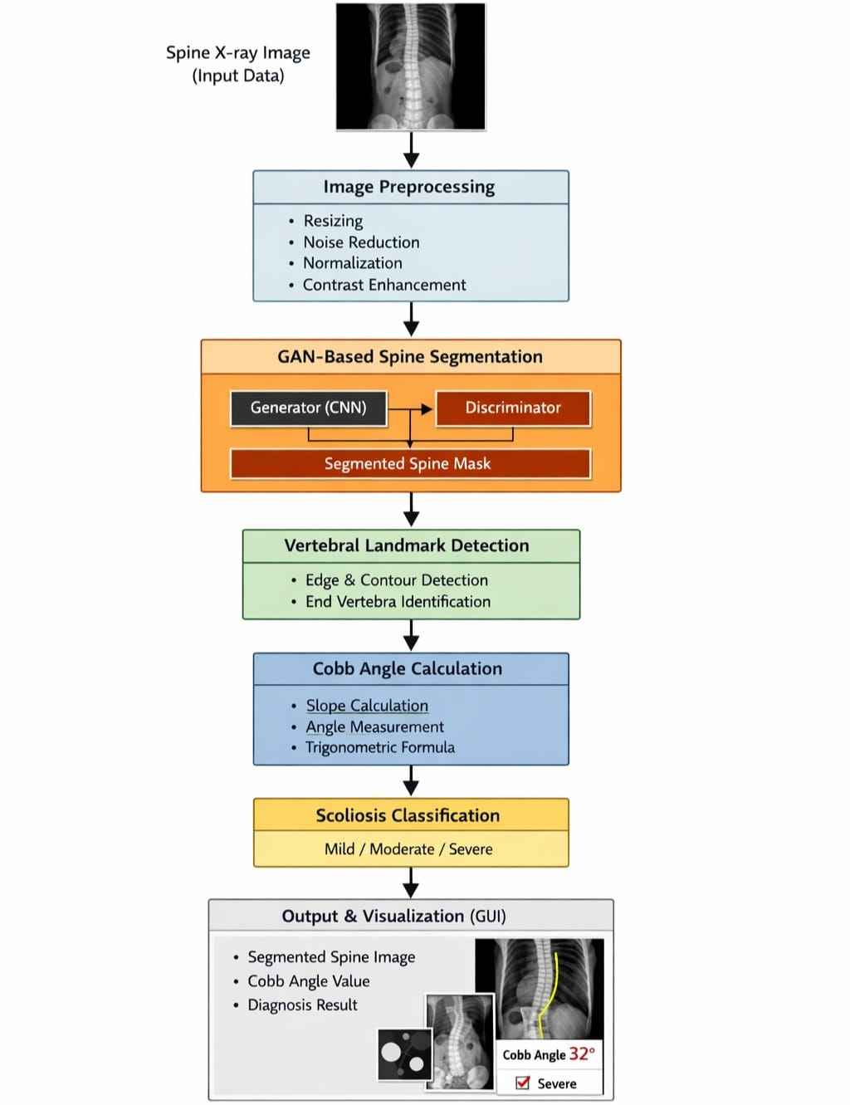
SYSTEM ARCHITECTURE

Slide 9
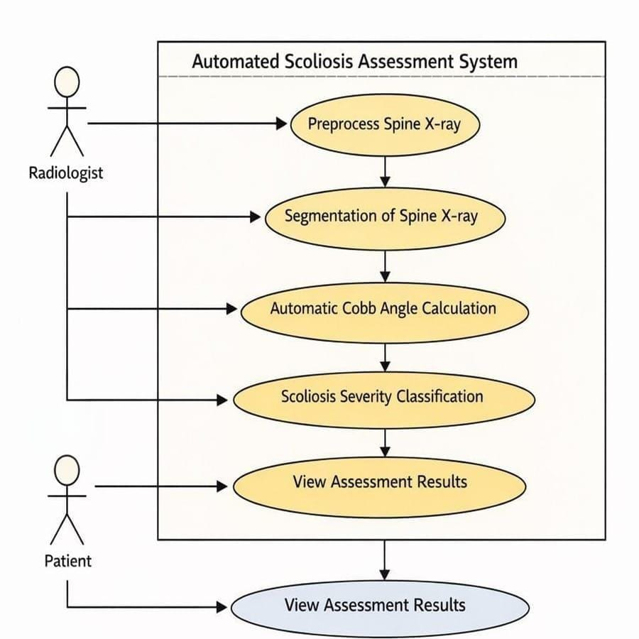
USE-CASE DIAGRAM

Slide 10
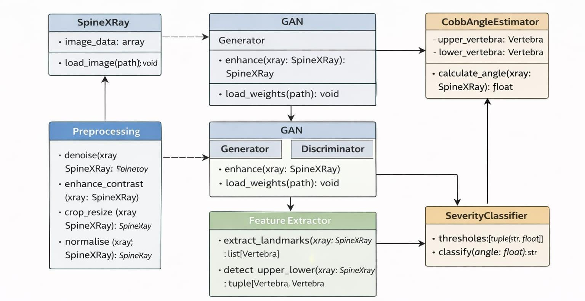
CLASS DIAGRAM

Slide 11
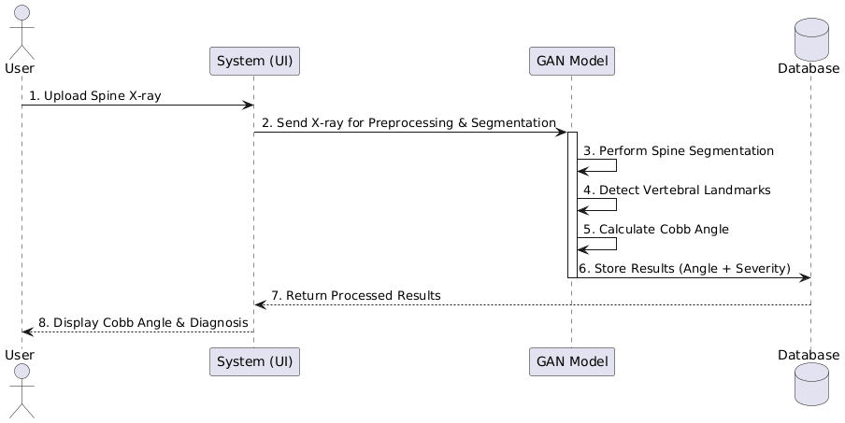
SEQUENCE DIAGRAM

Slide 12
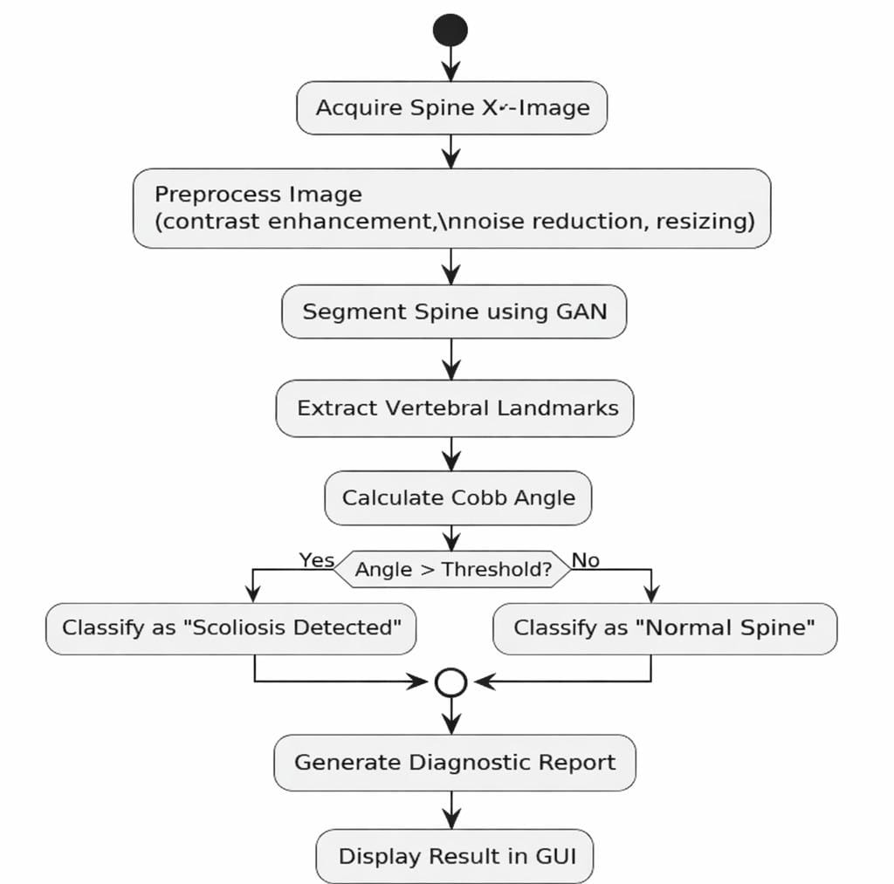
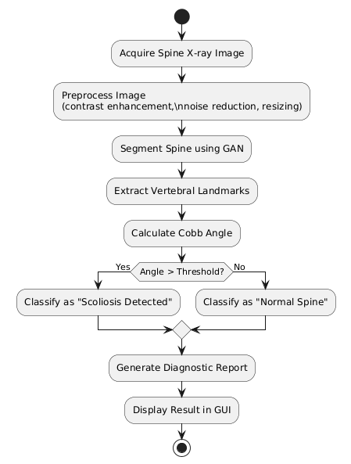
ACTIVITY DIAGRAM

Slide 13
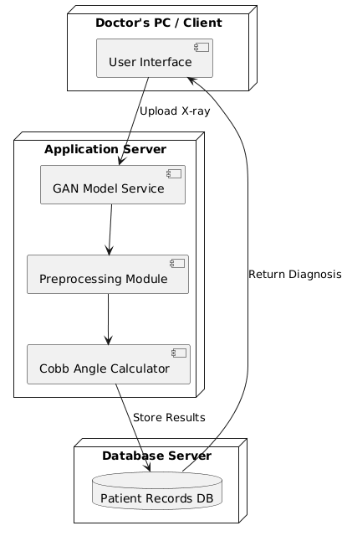
DEPLOYEMENT DIAGRAM

Slide 14
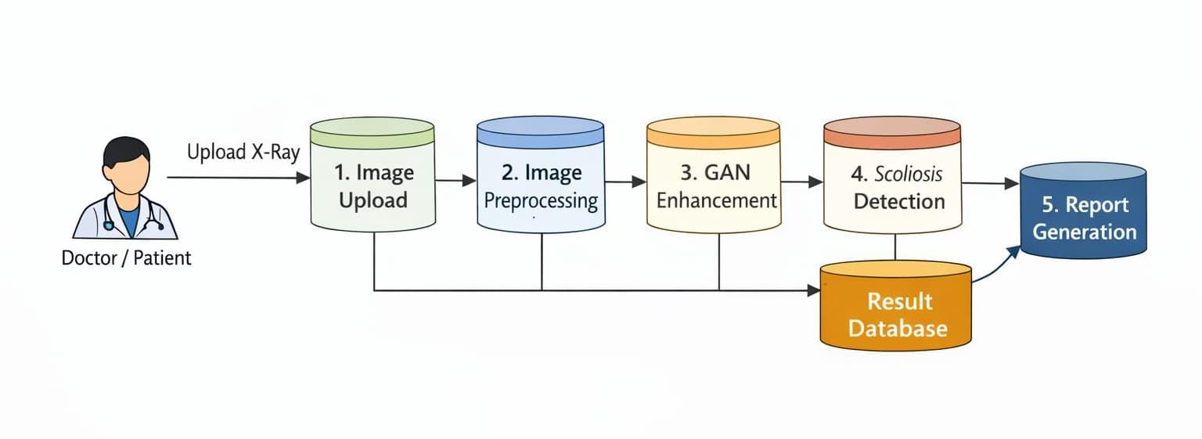
DATA FLOW DIAGRAM

Slide 15
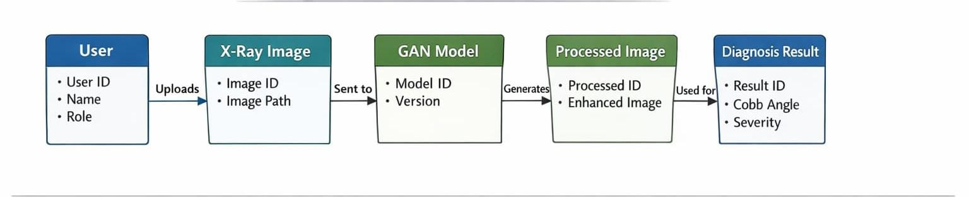
ER-DIAGRAM

Slide 16
SOFTWARE REQUIREMENTS
Operating System: Windows 10/11
Programming Language: Python– widely used in machine learning and image processing
applications.
Deep Learning Framework: PyTorch – for model architecture (GAN), training, and inference.
Image Processing Libraries: OpenCV and PIL – for preprocessing, segmentation visualization,
and feature enhancement.

Slide 17
HARDWARE REQUIREMENTS
Processor (CPU): Intel Core i7– for efficient parallel computation and faster data handling.
RAM: Minimum 16GB – to handle high-resolution X-ray images and batch processing during model training.
Display Monitor: High-resolution display for accurate visualization of segmentation results and Cobb angle overlays.

Slide 18
ALGORITHMS
Generative Adversarial Networks (GANs): Core deep learning model used for spine segmentation. Consists of:
Generator– generates spine segmentation masks
Discriminator– validates generated masks against real annotations
Conditional GAN (cGAN): GAN conditioned on input X-ray images. Ensures segmentation output is directly dependent on the given X-ray. Improves segmentation accuracy for different spine shapes and curvatures.
Convolutional Neural Networks (CNNs):Used inside GAN (Generator & Discriminator). Automatically extracts spatial features such as:
Vertebral edges
Curvature patterns
Spine alignment
Image Segmentation Algorithms: Pixel-level classification of spine vs background.
Output: Binary or multi-class segmentation mask of spinal column

Slide 19
Image Preprocessing Techniques:
Normalization– standardizes pixel values
Resizing– uniform input size
Noise reduction– Gaussian filtering
Feature Extraction Algorithms: Edge detection, Contour detection, Morphological
operations.
Used to identify: Vertebral boundaries ,Most tilted vertebrae.
Geometric angle calculation using: Lines drawn along upper & lower tilted vertebrae.
Final output: Degree of scoliosis severity.
Loss Functions: Adversarial Loss– improves realism of segmentation.
Dice Loss– improves overlap accuracy between predicted and ground truth masks.
Evaluation Metrics: Dice Similarity Coefficient (DSC),Intersection over Union (IoU),
Mean Absolute Error (MAE) for Cobb angle comparison.

Slide 20
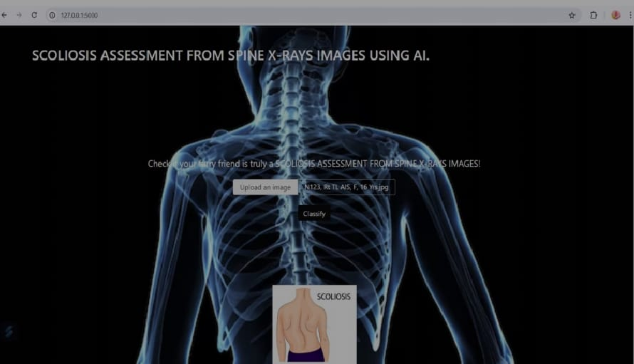
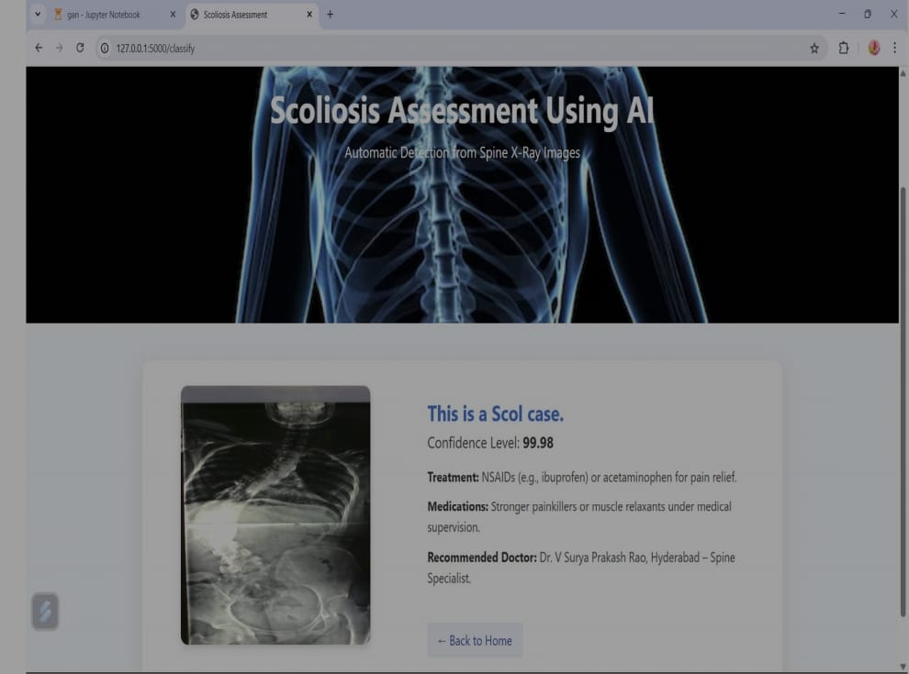
EXPECTED OUTPUT

Slide 21
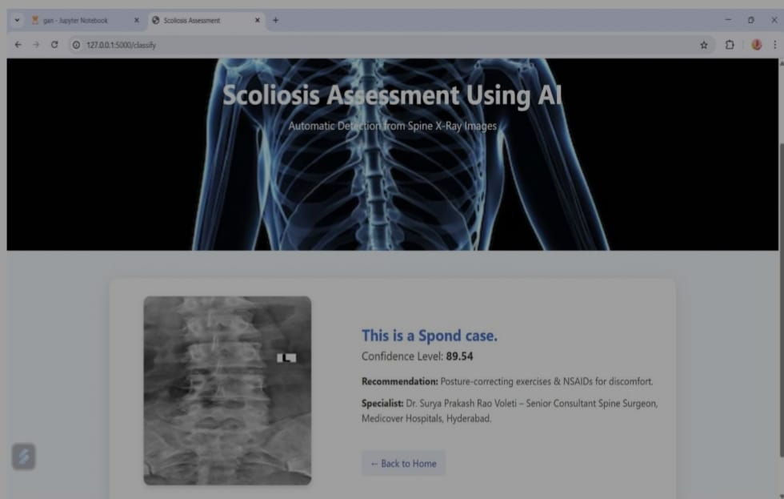
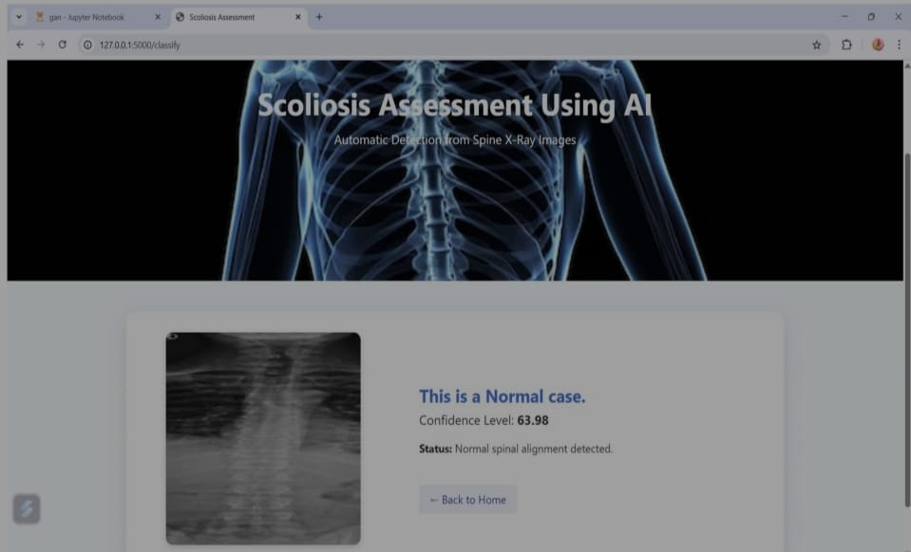

Slide 22
CONCLUSION
The project successfully developed an AI-based system using Generative Adversarial Networks (GANs) for automated scoliosis assessment from spine X-rays. The model efficiently performs spinal segmentation and Cobb angle estimation with high accuracy, minimizing manual effort and human error. Its user-friendly interface and robust performance make it suitable for clinical application, enabling faster, more reliable, and objective diagnosis. Overall, this project demonstrates the transformative potential of deep learning in medical imaging and establishes a foundation for future advancements in automated orthopedic diagnostics.

Slide 23
REFERENCES
Ronneberger, O., Fischer, P., & Brox, T. (2015). U-Net: Convolutional Networks for Biomedical Image Segmentation. In MICCAI.
Goodfellow, I., et al. (2014). Generative Adversarial Networks. Advances in Neural Information Processing Systems (NeurIPS).
Wang, Q., et al. (2018). Automatic detection of vertebral landmarks for Cobb angle measurement using deep learning. IEEE Transactions on Medical Imaging.
Drerup, B., & Hierholzer, E. (2014). Cobb angle measurement variability and the need for automated methods in scoliosis diagnosis. Spine Journal.
Tan, Z., et al. (2019). Automatic scoliosis diagnosis and measurement using deep learning techniques. Medical Image Analysis.

Slide 24
THANK YOU!!!

